Slide 1





10-minute pre | I3CE
Physics-Informed Road Digital Twins for Pavement Maintenance
A closed-loop framework and fracture learning taxonomy
Xiaofang Wen, Yinglin Wang, Soheila Kookalani, Brian Sheil
University of Cambridge / Zhejiang University
Surface observations → hidden fracture state
i3CE 2026

Slide 2
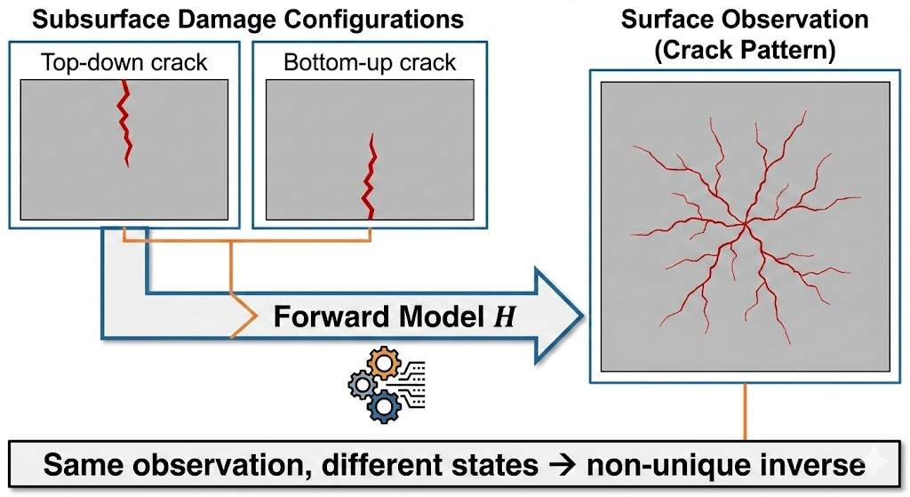
1. Motivation: the observability gap
Routine condition surveys observe symptoms; maintenance needs mechanical states.
What we usually observe
What maintenance decisions need
Routine surveys observe symptoms
• surface cracking
• rutting and roughness
• deflection basin
• layer interfaces or moisture proxies
• damage state
• layer stiffness
• crack mechanism
• remaining useful life and risk
surface cracking
rutting and roughness
deflection basin
GPR layer / moisture proxies
observability gap
Same visible pattern, different hidden mechanical states
Visible distress is an observation, not a unique mechanical diagnosis.
Key point: visible surface distress does not uniquely reveal the internal deterioration mechanism.
I3CE pre | Paper 454 | 2
2

Slide 3
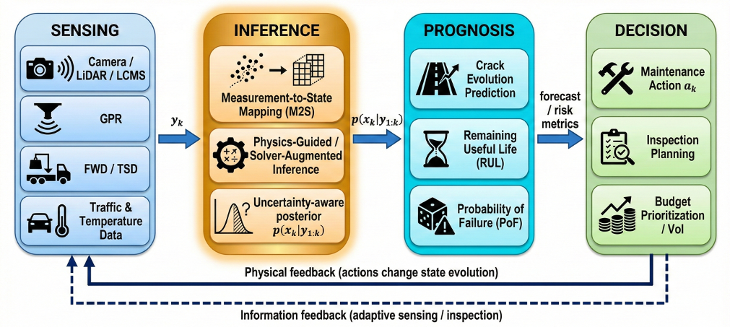
2. Closed-loop road digital twin framework
The proposed RDT is a maintenance loop, not just a 3D model or monitoring dashboard.
Sensing
Inference
Prognosis
Decision
xₖ → yₖ
y₁:ₖ → p(xₖ|y₁:ₖ)
p(xₖ|y₁:ₖ) → risk
risk → aₖ
camera / LCMS FWD / TSD GPR / traffic
measurement-to-state state posterior uncertainty
crack evolution RUL / PoF forecast intervals
maintenance action inspection planning budget priority
inference is the bottleneck
Physical feedback: actions change state evolution; information feedback: inspections adapt sensing.
I3CE pre | Paper 454 | 3
3

Slide 4
3. Measurement-to-state inference is ill-posed
The task is to infer hidden state xₖ from indirect, noisy observations yₖ.
yₖ = ℋ(xₖ) + εₖ → estimate p(xₖ | y₁:ₖ)
Non-uniqueness
Similar surface cracks can reflect top-down cracking, bottom-up fatigue, or thermal effects.
Noise amplification
Small errors in measured deflections can produce large changes in inferred layer moduli.
Model mismatch
Field pavements are heterogeneous, history-dependent, and only partly represented by simplified models.
Therefore observations alone are not enough; physics, priors, multi-modal coupling and uncertainty treatment are needed.
I3CE pre | Paper 454 | 4
4

Slide 5
4. Why fracture is difficult for standard PINNs
Residual-based PINNs are useful, but fracture violates many smooth-PDE assumptions.
Standard residual-based PINN
Physics enters as a pointwise PDE residual in the training loss. This works best when the target field is smooth and constraints can be handled softly.
Discontinuous fields
cracks create jumps and localisation
Crack-tip singularities
stress concentration is hard for smooth MLPs
Irreversibility
damage should not heal during evolution
Non-convex energy
multiple possible crack paths may compete
Message: the issue is not just hyperparameter tuning; it is a mismatch between formulation and fracture physics.
I3CE pre | Paper 454 | 5
5

Slide 6
5. Physics-injection taxonomy
“Physics-informed” should be treated as a design choice: where does physics enter the pipeline?
Strong-form PINN
Pointwise PDE residual + simple baseline – weak near singularities
Variational PINN
Energy minimisation + aligned with fracture theory – non-convexity and constraints
Differentiable solver
Solver in computation graph + hard constraints and inversion – implementation and memory cost
Sequential assimilation
Bayesian state update + online uncertainty-aware DT – high-dimensional approximations
Fracture-aware RDTs need energy- or solver-based physics, not residual-only losses.
For fracture-aware RDTs, energy-based or solver-based components are likely more suitable than relying only on residual losses.
I3CE pre | Paper 454 | 6
6

Slide 7
6. Preliminary example: energy-based fatigue fracture learning
Deep Ritz method applied to phase-field fatigue fracture and compared with FEM.
Setup
Cycles to failure: DRM vs FEM reference
Umax | Nf FEM | Nf DRM | Error
0.12 | 82 | 81 | −1.2%
0.11 | 117 | 113 | −3.4%
0.10 | 170 | 161 | −5.3%
0.09 | 255 | 231 | −9.4%
0.08 | 396 | 342 | −13.6%
What works
Energy formulation reproduces the S–N trend with 1–14% underestimation.
What remains
Smooth MLP under-resolves the crack-tip stress concentration; enriched representations are needed.
SENT specimen, displacement-controlled fatigue
• DRM minimises global fracture energy
• No explicit crack-tracking rule
I3CE pre | Paper 454 | 7
7

Slide 8
7. Implications: toward uncertainty-aware road DTs
Inference uncertainty propagates into prognosis and maintenance decisions.
Observation uncertainty
State-inference uncertainty
Prognostic uncertainty
Decision risk
Take-home 1
RDTs need to infer hidden mechanical states, not only monitor surface condition.
Take-home 2
M2S inference is ill-posed, so physics and uncertainty treatment are essential.
Take-home 3
For fracture-aware DTs, the physics-injection point matters.
Thank you — I welcome your questions.
I3CE pre | Paper 454 | 8
8

Slide 9
Backup slides
for technical Q&A
I3CE pre | Paper 454 | Backup 9
9

Slide 10
Backup A. Observation sources in the RDT loop
Each modality is informative for some states but introduces specific bias and uncertainty.
Modality | Measured quantity | Typical noise / bias
Camera / LCMS | surface cracking, rutting, roughness | occlusion, illumination, wetness, calibration drift
FWD / TSD | deflection basin under load | temperature, load variability, support-condition confounding
GPR | layer interface, moisture anomalies | calibration, dielectric assumptions, EM variability
Traffic / temperature | load proxies, thermal state | sparsity, aggregation bias
Use this slide if someone asks how the framework connects to real sensing technologies.
I3CE pre | Paper 454 | 10
10

Slide 11
Backup B. M2S formalisation
The inverse problem is about recovering a posterior over latent states, not only a point estimate.
State-space view
Latent state: xₖ Observations: yₖ Actions: aₖ Observation model: yₖ = ℋ(xₖ) + εₖ Inference target: p(xₖ | y₁:ₖ)
Why posterior matters
A single deterministic estimate can hide diagnostic ambiguity. A posterior can express uncertainty over mechanisms, such as superficial cracking versus deeper structural fatigue.
Q&A phrase: “The DT should carry uncertainty forward, because maintenance decisions are risk decisions.”
I3CE pre | Paper 454 | 11
11

Slide 12
Backup C. Full method map by physics-injection point
The taxonomy is intended to guide formulation choice, not to rank one method universally.
Family | Physics injection | Strength | Limitation
Strong-form PINN | pointwise PDE residual in loss | simple; smooth PDEs | poor near singularities; soft constraints
Variational PINN | energy minimisation | global balance; fracture theory | non-convexity; irreversibility
Differentiable solver | solver computation graph | hard constraints; gradient-based inversion | implementation and memory cost
Sequential assimilation | Bayesian update | online updating; uncertainty-aware | ensemble approximations for high-dimensional states
Q&A phrase: “Physics-informed learning is a modelling design space, not one algorithm.”
I3CE pre | Paper 454 | 12
12

Slide 13
Backup D. Scope, limitations and next steps
This is a conceptual framework supported by preliminary numerical evidence.
Current scope
• Conceptual closed-loop RDT framework • M2S inverse-problem framing • Fracture-learning taxonomy • Preliminary DRM/FEM comparison
Limitations
• No field data yet • Single SENT geometry • Idealised loading, R = 0 • No network-scale deployment • Crack-tip under-resolution remains
Next steps
• Multi-modal field sensing • Identifiability analysis • Differentiable solvers / hybrid surrogates • Calibrated prediction intervals • Network-level optimisation
I3CE pre | Paper 454 | 13
13

Slide 14
Backup E. Likely questions and short answers
Keep answers modest: framework first, validation next.
Is this different from PMS?
Yes. PMS often plans from condition indicators; this work targets the missing inference layer from observations to latent mechanical state.
Do you have field data?
Not in this paper. The next step is multi-modal field data: surface sensing + FWD/TSD + GPR.
Why not standard PINNs?
Fracture has discontinuities, singularities, irreversibility and non-convex energy; residual-only learning is not enough.
Why not standard PINNs?
Fracture has discontinuities, singularities, irreversibility and non-convex energy; residual-only learning is not enough.
Is DRM fully validated?
No. It is preliminary evidence showing the value and limitation of energy-based physics injection.
Is DRM fully validated?
No. It is preliminary evidence showing the value and limitation of energy-based physics injection.
Surface observations → hidden fracture state
I3CE pre | Paper 454 | 14
14

